Slide 1

Vancouver Parks and cafes
Where it is nice to study, work and relax

Slide 2
Problem
There are so many cafes all around Vancouver it is often hard to choose one.
For student especially when they are looking for relaxing places and calm for studying.
But also for professionals or even anybody looking for some peace in the city.

Slide 3
Let’s cluster parks and cafes in Vancouver to find the best place
We’ll first get some data for both parks and cafes, then we’ll clean and sort the dataframes.
We can then cluster them together.
Finally we will display the results on a map.

Slide 4
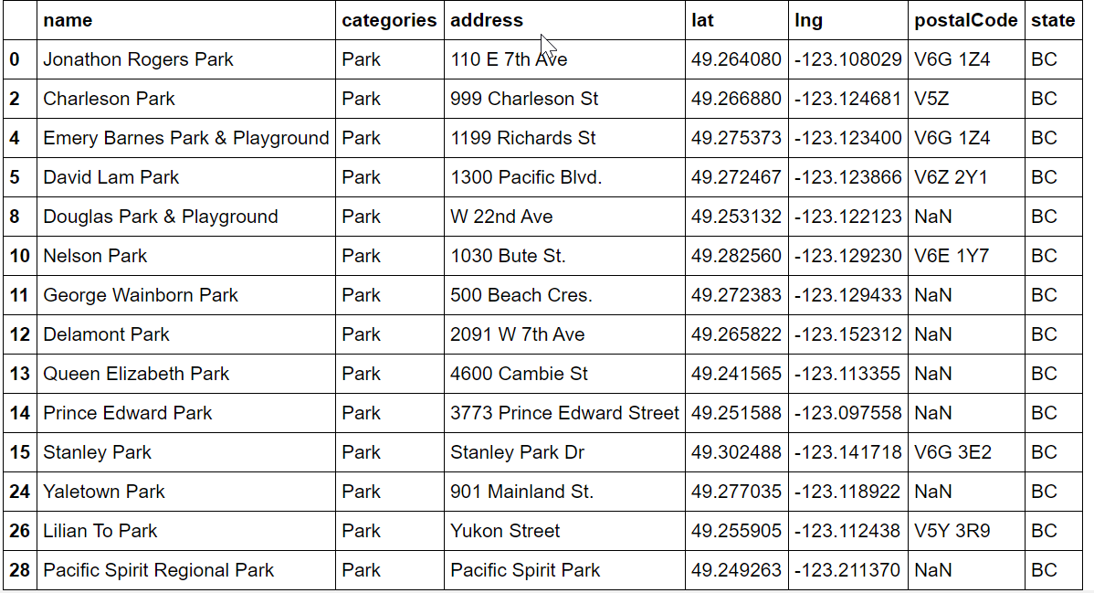
Parks in Vancouver
This is the cleaned list extracted from Foursquare:

Slide 5
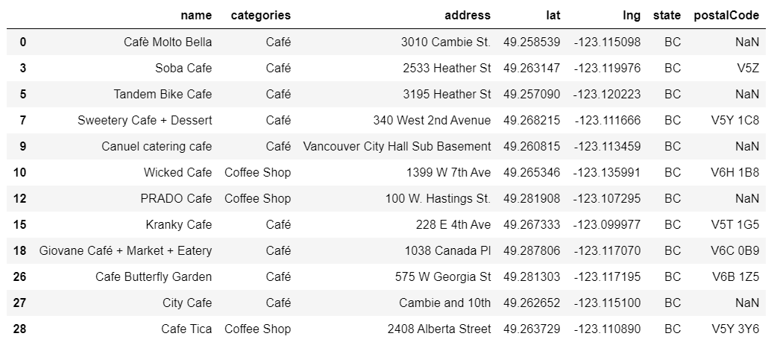
Cafes in Vancouver
This list is also cleaned and extracted from Foursquare:

Slide 6
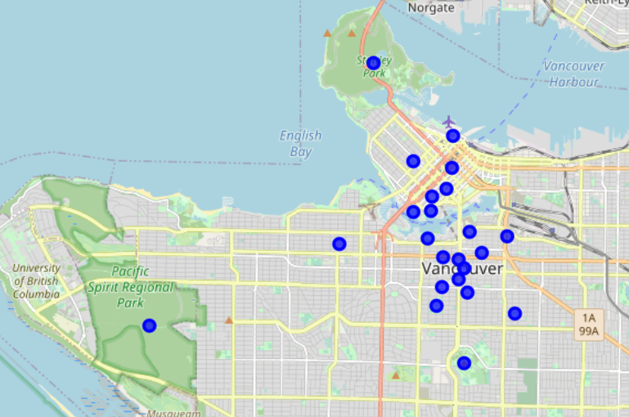
Final Map
This are the best places to go grab a coffee before heading to the park

